Slide 1
Computational Geometry for Spatial and Design Reasoning Lecture 4: Vector Math & Transformation Matrices

Slide 2
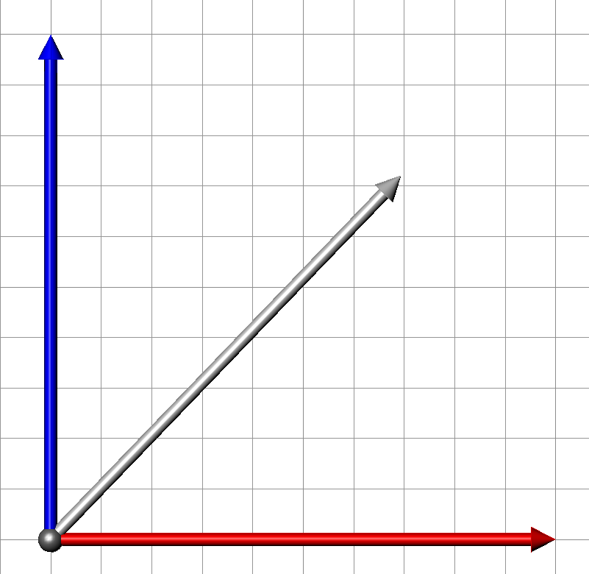
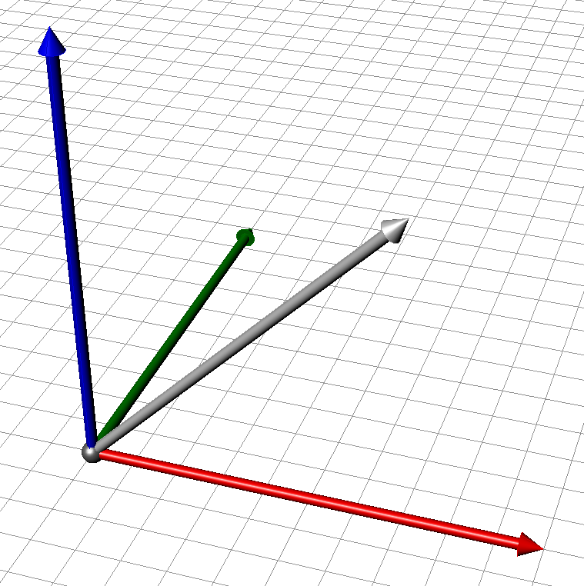
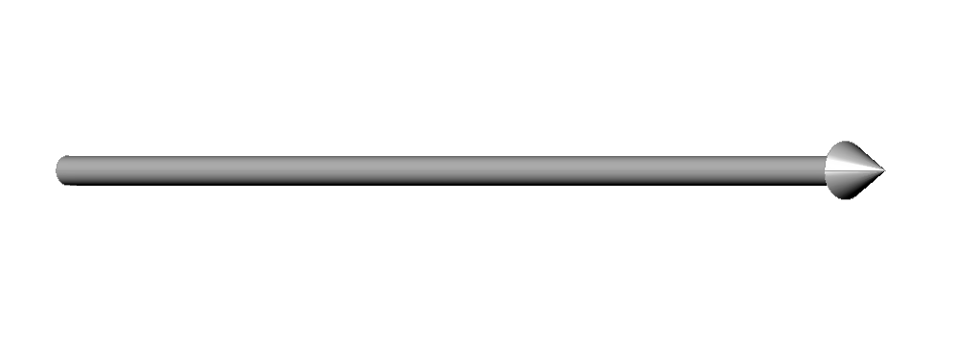
Notes
For today’s discussion, let’s get out of the business of
thinking in specific dimensional space (2, 3, …) and
start thinking in spaces of arbitrary dimension, n.
For concrete examples, we’ll generally use n =3.
If you get lost, just substitute 2 or 3 in for n (your preference) in your thought process. Better yet, try it out each way, then maybe even for n=1.
R^{n} | n=1
R^{n} | n=2
R^{n} | n=3
Notes:
Variables can be
Numerical
Integers

Slide 3
Points and Vectors
Both vectors and points are expressed mathematically the same way:
As sets of n coordinates where n is the dimensionality of the space (ie 3)
Their intent is different:
A point expresses location or position in the space
A vector expresses directedness and magnitude. This direction is independent of any point of application.
A vector can be applied at a point, the combination of location and magnitude is typically of size 2n
Notes:
Variables can be
Numerical
Integers

Slide 4
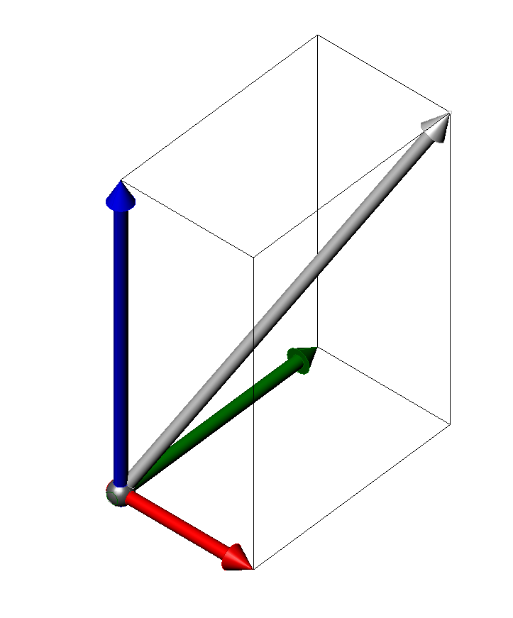
Vectors
So far in life, you’ve not seen any distinction made between a vector and an array of numbers.
Numerical view
a ∈R^{n}
Vector view
3
5
7
??
≈
Notes:
Variables can be
Numerical
Integers

Slide 5
Notation on Matrices
Rows tend to govern
An n x m matrix has n rows and m columns, and n x m entries
3
5
7
a 3 x 1 matrix
2 | 1 | 3
a 1 x 3 matrix
2 | 1 | 3
6 | 4 | 5
3 | 6 | 3
7 | 5 | 7
2 | 1 | 3
6 | 4 | 5
7 | 5 | 7
a 3 x 3
or n²
“square” matrix
a 4 x 3 matrix
Notes:
Variables can be
Numerical
Integers

Slide 6
Matrix multiplication - refresher
I can multiply 2 matrices together if
the # of columns of the first equals the # of rows of the second
3
5
7
2 * 3 = 6
1 * 5 = 5
3 * 7 = 21
6+5+21= 32
2 | 1 | 3
x
=
32
1 x 3
x
3 x 1
=
1 x 1
2 | 1 | 3
6 | 4 | 9
7 | 5 | 8
3
5
7
32
101
102
2*3 + 1*5 + 3*7 = 32
6*3 + 4*5 + 9*7 = 101
7*3 + 5*5 + 8*7 = 102
3 x 3
x
3 x 1
=
3 x 1
Notes:
Variables can be
Numerical
Integers

Slide 7
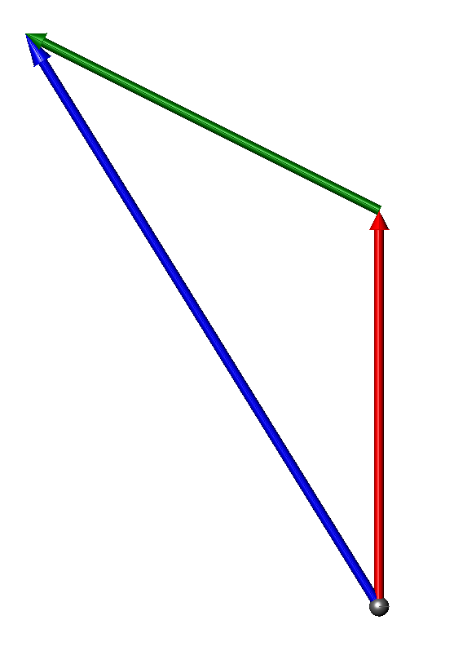
Algebras
Addition
a + b = c
a_{i}
a_{j}
a_{k}
b_{i}
b_{j}
b_{k}
a_{i}+b_{i}
a_{j}+b_{i}
a_{k}+b_{k}
+
=
a₀₀ | a₀₁ | a₀₂
a₁₀ | a₁₁ | a₁₂
a₂₀ | a₂₁ | a₂₂
b₀₀ | b₀₁ | b₀₂
b₁₀ | b₁₁ | b₁₂
b₂₀ | b₂₁ | b₂₂
a₀₀+b₀₀ | a₀₁+b₀₁ | a₀₂+b₀₂
a₁₀+b₁₀ | a₁₁+b₁₁ | a₁₂+b₁₂
a₂₀+b₂₀ | a₂₁+b₂₁ | a₂₂+b₂₂
+
=

Slide 8
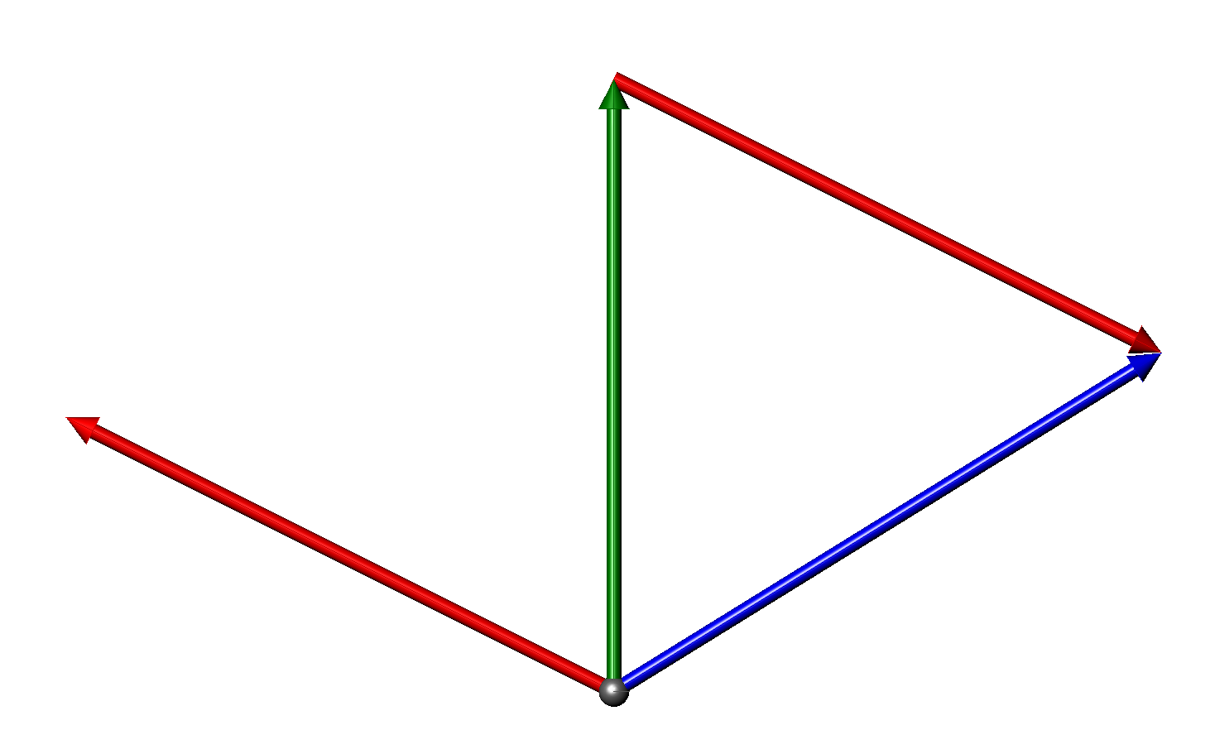
Algebras
Subtraction
a - b = c
a_{i}
a_{j}
a_{k}
b_{i}
b_{j}
b_{k}
a_{i}-b_{i}
a_{j}-b_{i}
a_{k}-b_{k}
-
=
a₀₀ | a₀₁ | a₀₂
a₁₀ | a₁₁ | a₁₂
a₂₀ | a₂₁ | a₂₂
b₀₀ | b₀₁ | b₀₂
b₁₀ | b₁₁ | b₁₂
b₂₀ | b₂₁ | b₂₂
a₀₀-b₀₀ | a₀₁-b₀₁ | a₀₂-b₀₂
a₁₀-b₁₀ | a₁₁-b₁₁ | a₁₂-b₁₂
a₂₀-b₂₀ | a₂₁-b₂₁ | a₂₂-b₂₂
-
=

Slide 9
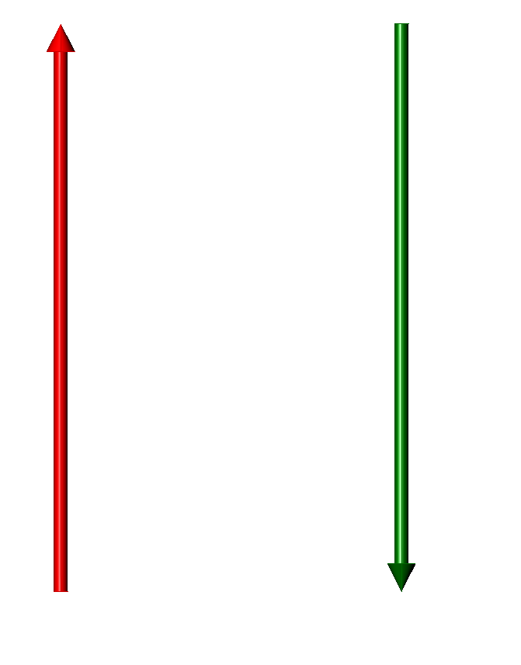
Algebras
Arithmetic Inverse
b = - a
a_{i}
a_{j}
a_{k}
-a_{i}
-a_{j}
-a_{k}
Y

Slide 10

Algebras
Multiplicative Inverse
b = a⁻¹
$$\vec{b}={\vec{a}}^{−1}$$
a_{i}
a_{j}
a_{k}
-a_{i}
-a_{j}
-a_{k}

Slide 11
Normalized vector
A vector with the same direction as and a length of 1:

Slide 12
Multiplication
Among the types of vector multiplication
Scalar multiplication ab
Inner product (dot product) a • b
Outer product a ∗ b
Cross product a × b

Slide 13
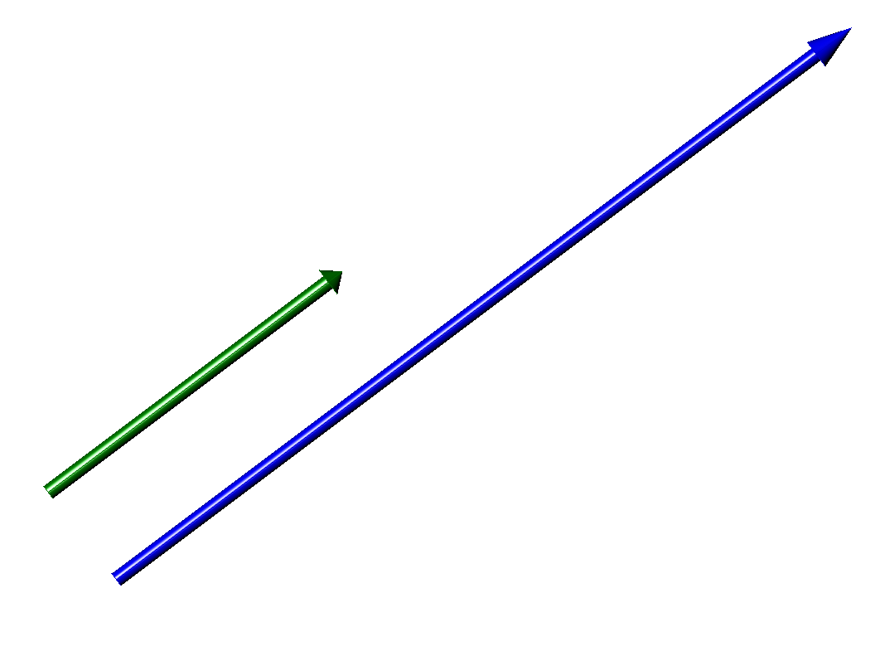
Multiplication
Scalar multiplication: multiplication by a real number
ab = c
b_{i}
b_{j}
b_{k}
ab_{i}
ab_{j}
ab_{k}
=
a

Slide 14
inner product / dot product
R^{n} • R^{n} → R
a^{T} * b = c
A single number:
R^{n} X R^{n} → R
a_{i}
a_{j}
a_{k}
b_{i}
b_{j}
b_{k}
•
=
a_{i}*b_{i} + a_{j}*b_{j} + a_{k}* b_{k}
3
5
7
2 * 3 = 6
1 * 5 = 5
3 * 7 = 21
6+5+21= 32
2 | 1 | 3
x
=
32
1 x 3
x
3 x 1
=
1 x 1

Slide 15
inner product / dot product
R^{n} • R^{n} → R
EXAMPLE: The length of a vector is its inner product with itself
·
S

Slide 16
inner product / dot product
R^{n} • R^{n} → R
EXAMPLE: The length of a vector is its inner product with itself
·
S
This is why Euclidean space is sometimes called an
“inner product space”

Slide 17
inner product / dot product
This is the answer I’m going to be looking for
“Find the length of vector “
·
S

Slide 18







Multiplication
More generally, the dot product is:
(length of a) * (length of b) * (cosine of angle between a and b)
$$\text{·}$$
If one of the vectors (a) is length = 1
The dot product = the projected length of b onto a,
And the vector from the origin of a to this point is
$$\vec{b}\text{·}\hat{a}$$
$$\hat{a}$$
$$\vec{b}\text{·}\hat{a}$$
If both of the vectors (a,b) are length = 1
The dot product = the cosine of the angle between the vectors
$$\hat{b}\text{·}\hat{a}$$
$$\hat{a}\hat{\text{·}b}=cos\left(∠\hat{a}\hat{b}\right) ∠\hat{a}\hat{b}= \cos^{−1}{(\hat{a}\hat{\text{·}b})}$$
$$\hat{a}$$
$$\vec{b}\text{·}\hat{a}$$

Slide 19
inner product / dot product
Examples:
, and a and b are parallel
More generally, the dot product is:
The (length of a) * (length of b) * (cosine of angle between a and b)
S
sin(45°)=cos(45°)=

Slide 20
inner product / dot product
Examples:
, and a and b are perpendicular
More generally, the dot product is:
The (length of a) * (length of b) * (cosine of angle between a and b)
S

Slide 21
inner product / dot product
Examples:
, and a and b are perpendicular
More generally, the dot product is:
The (length of a) * (length of b) * (cosine of angle between a and b)
S
sin(45°)=cos(45°)=
sin(135°)= cos(135°)=

Slide 22
inner product / dot product
“Find the angle between and “

Slide 23
inner product / dot product
Or simply
“Find the angle between and “

Slide 24
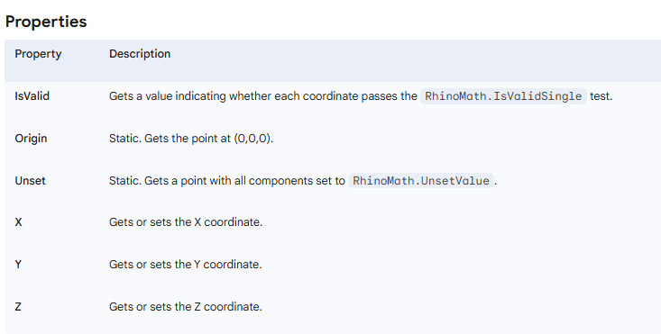
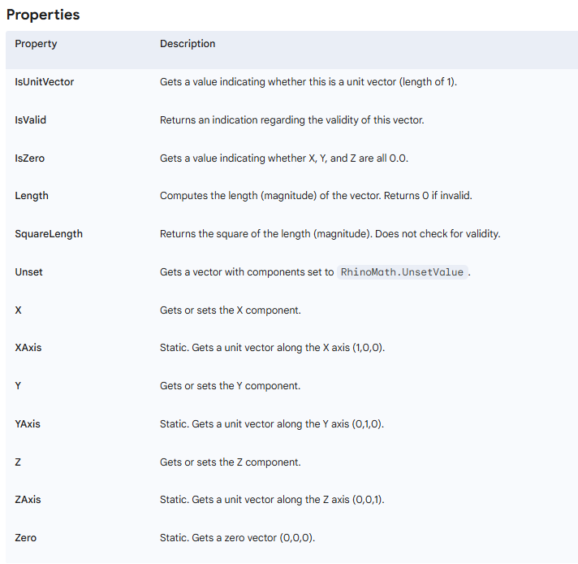
Point3f and Vector3f in Rhino.Common
Point3f
Vector3f

Slide 25
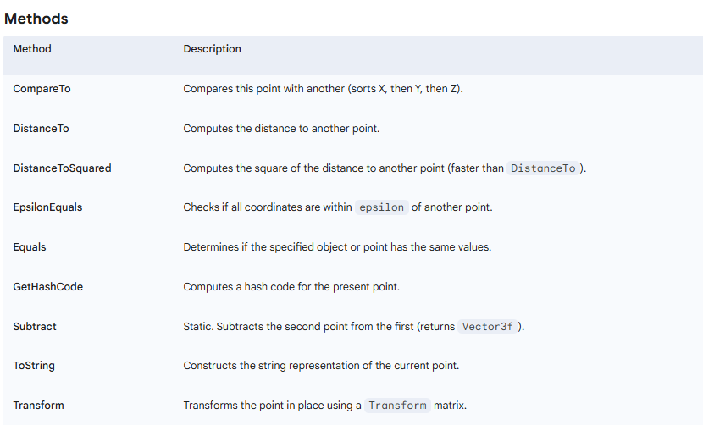
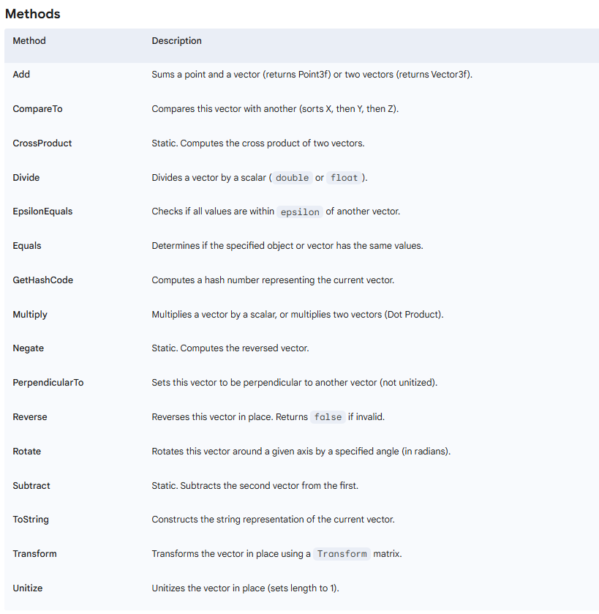
Point3f and Vector3f in Rhino.Common
Point3f
Vector3f

Slide 26
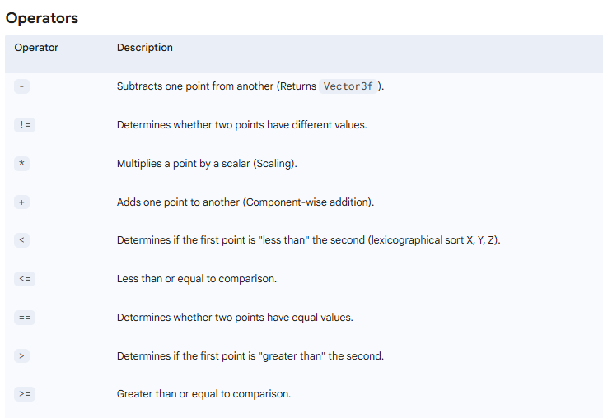
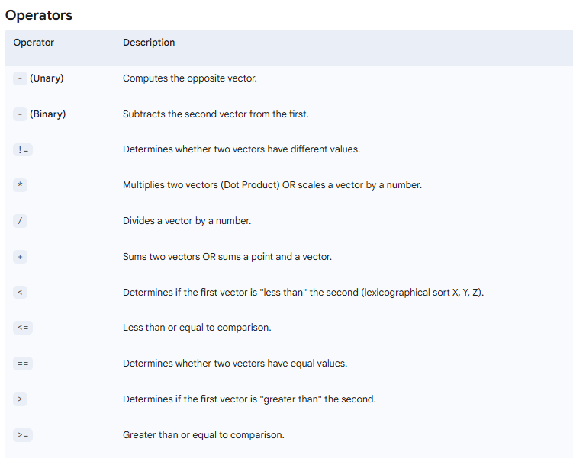
Point3f and Vector3f in Rhino.Common
Point3f
Vector3f

Slide 27
In class exercise
Ask the user for three points, representing the start point of 2 vectors and the 2 end points. Using only vector functions and scalar algebra (+,-,*,/, ·, acos)
Determine the lengths of each vector
Determine the angle <ab
Determine the projection of the end point of b on a
p₂
p₀
p₁

Slide 28
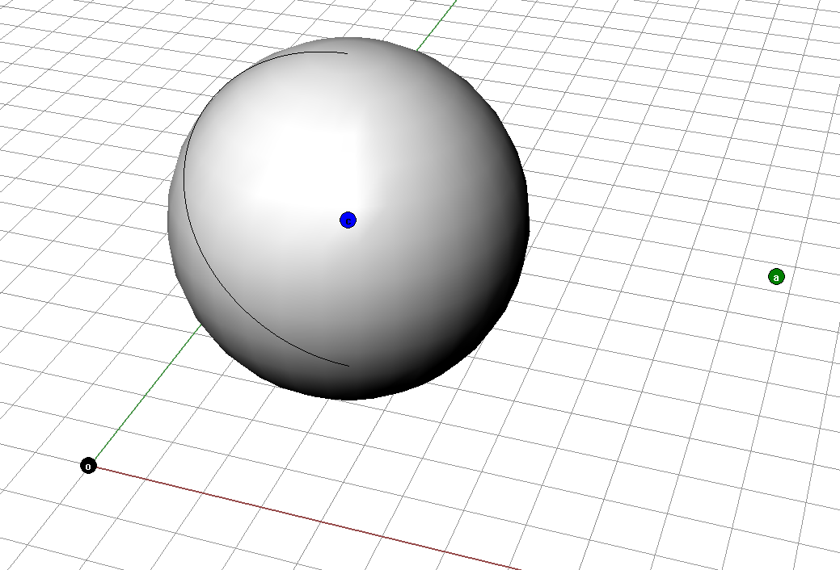
inner product / dot product
“how far (d) is point a from the surface of
a sphere e with center at c and radius r_{e} “
r_{e}
d?
e

Slide 29
inner product / dot product
“how far (d) is point a from the surface of
a sphere e with center at c and radius r_{e} “
r_{e}
d
e

Slide 30
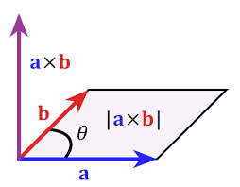
Cross product
The cross product of 2 vectors is another way of computing a multiplication of 2 vectors.
a x b produces a new vector c,
perpendicular to the plane defined by a and b
With the magnitude |a| |b| sin(∠ab)
In the direction defined by the right hand rule
This magnitude is equal to the area defined by the quadrilateral defined by a and b
If a and b are unitized, |axb| = sin (∠Θ)
Cross product is a great way to determine facts about perpendicularity, where dot product is a great way to determine facts about parallelism.

Slide 31
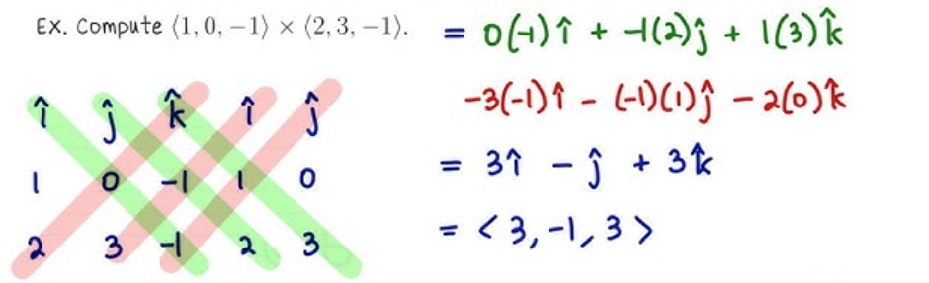
Computing the cross product

Slide 32
In class exercise
Ask the user for three points, representing the start point of 2 vectors and the 2 end points. Using only vector functions and scalar algebra (+,-,*,/, ·, acos)
Determine the lengths of each vector
Determine the angle <ab
Determine the projection of the end point of b on a
Ask the user for a 4th point p₃, and determine the distance from the plane p₀p₁p₂ + to p₃
p₃
p₂
p₀
p₁

Slide 33
Transformation matrices
Matrices are used to do all the basic (“Euclidean” or “linear”) object modification in software like Rhino:
Translation
Rotation
Mirror
Shear
We do these transformations on each critical point and then connect the shapes together.
The are also used for viewing of objects:
Parallel projection
Perspective projection

Slide 34
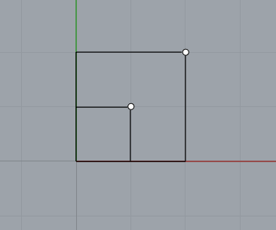
Transformation matrices - basics
Example: scaling a rectangle
2
2
0
2 | 0 | 0
0 | 2 | 0
0 | 0 | 2
1
1
0
=
x
New point
location
Transformation
matrix
Original point
location

Slide 35
Transformation matrices - basics
Example: scaling a rectangle
The factor for the old point’s
x contribution to the new point’s x
2
2
0
2 | 0 | 0
0 | 2 | 0
0 | 0 | 2
1
1
0
=
x
New point
location
Transformation
matrix
Original point
location

Slide 36
Transformation matrices - basics
Example: scaling a rectangle
The factor for the old point’s
y contribution to the new point’s x
2
2
0
2 | 0 | 0
0 | 2 | 0
0 | 0 | 2
1
1
0
=
x
New point
location
Transformation
matrix
Original point
location

Slide 37
Transformation matrices - basics
Example: scaling a rectangle
The factor for the old point’s
z contribution to the new point’s x
2
2
0
2 | 0 | 0
0 | 2 | 0
0 | 0 | 2
1
1
0
=
x
New point
location
Transformation
matrix
Original point
location

Slide 38
Transformation matrices - basics
Example: scaling a rectangle
The factor for the old point’s
x contribution to the new point’s y
2
2
0
2 | 0 | 0
0 | 2 | 0
0 | 0 | 2
1
1
0
=
x
New point
location
Transformation
matrix
Original point
location

Slide 39
Transformation matrices - basics
Example: scaling a rectangle
The factor for the old point’s
y contribution to the new point’s y
2
2
0
2 | 0 | 0
0 | 2 | 0
0 | 0 | 2
1
1
0
=
x
New point
location
Transformation
matrix
Original point
location

Slide 40
Transformation matrices - basics
Example: scaling a rectangle
The factor for the old point’s
z contribution to the new point’s y
2
2
0
2 | 0 | 0
0 | 2 | 0
0 | 0 | 2
1
1
0
=
x
New point
location
Transformation
matrix
Original point
location

Slide 41
Linear Transformations and Matrix Multiplication
a_{l x m} x b_{m x n} → c_{l x n}
a_{4 x 3} x b_{3 x 2} → c_{4 x 2}

Slide 42
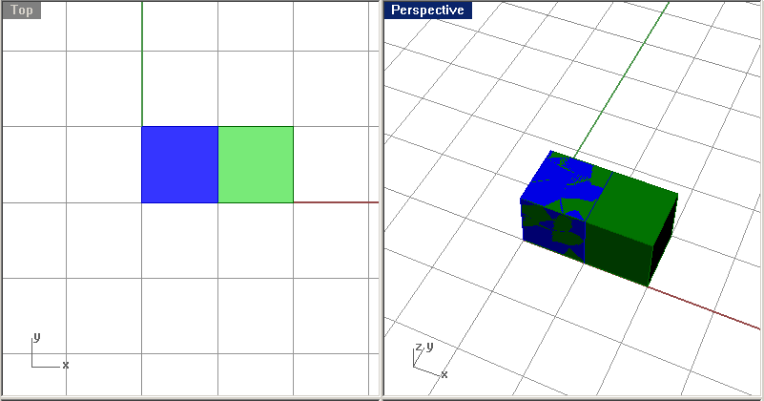
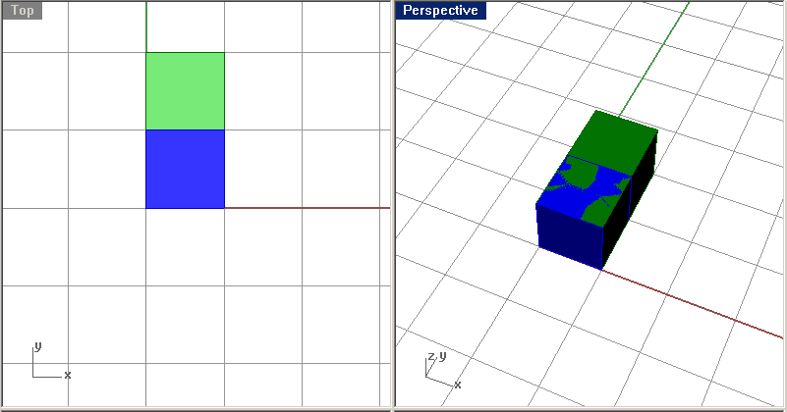
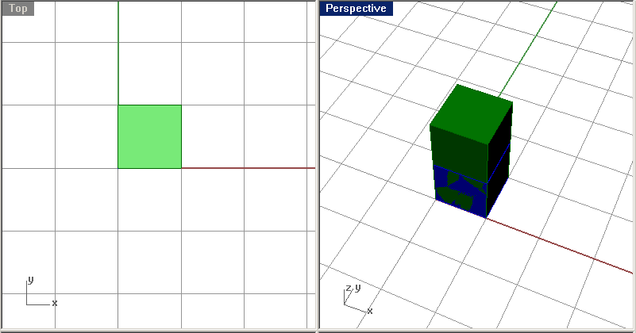
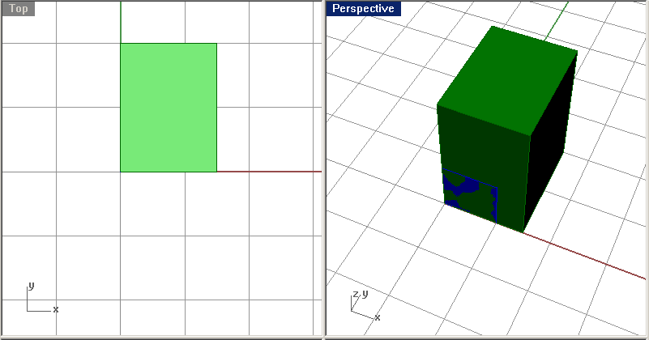
Scaling
Notes:
Variables can be
Numerical
Integers

Slide 43
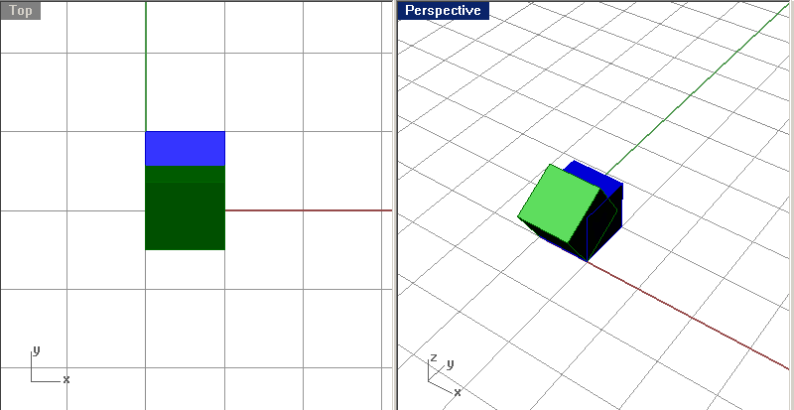
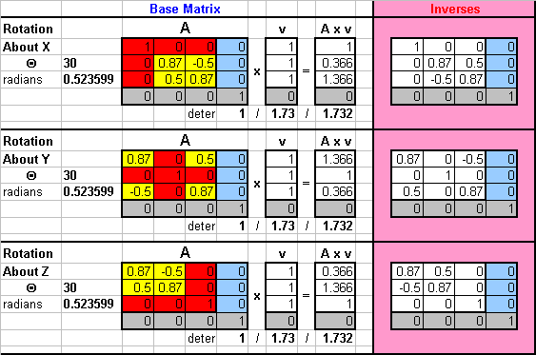
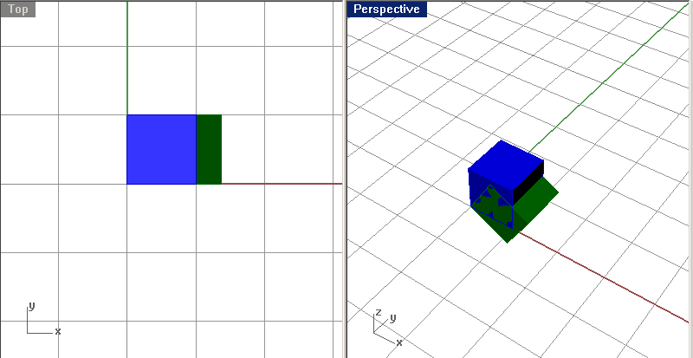
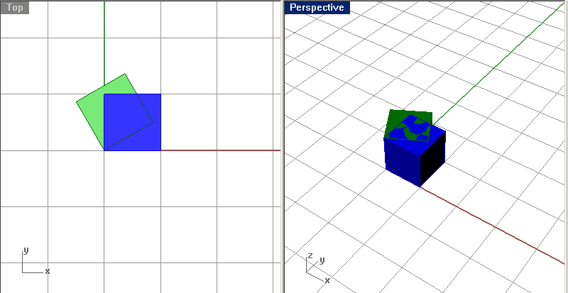
Rotation
1
1
1
1
1
1
Notes:
Variables can be
Numerical
Integers

Slide 44
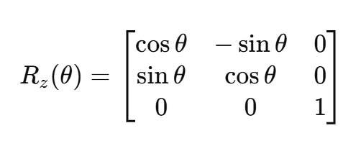
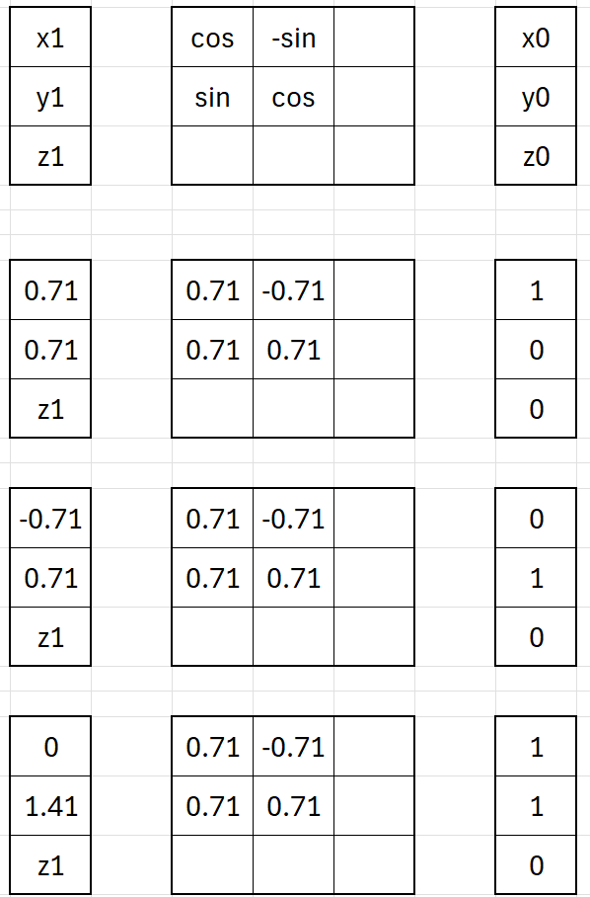
(.71,.71)
(1,0)
(0,1)
(-.71,.71)
(0,1.41)
(1,1)
Notes:
Variables can be
Numerical
Integers

Slide 45
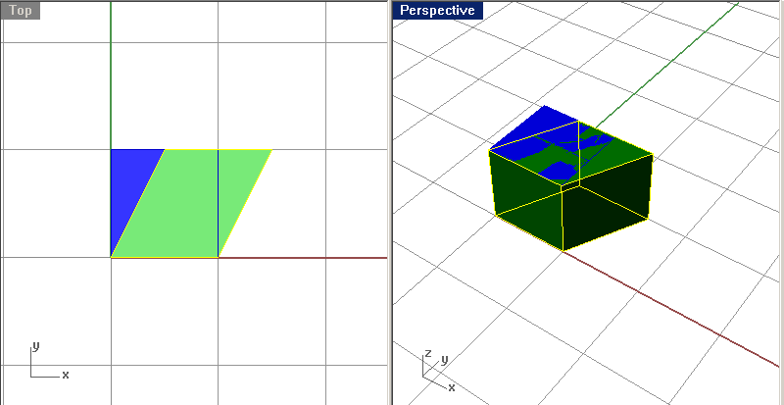
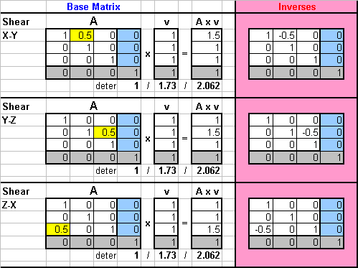
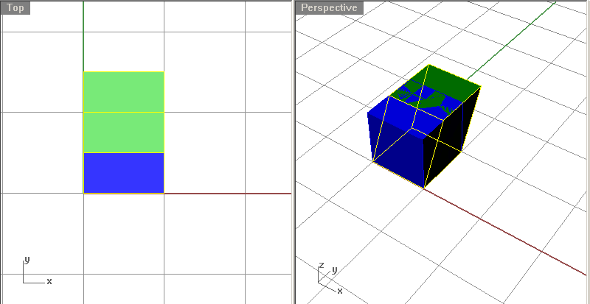
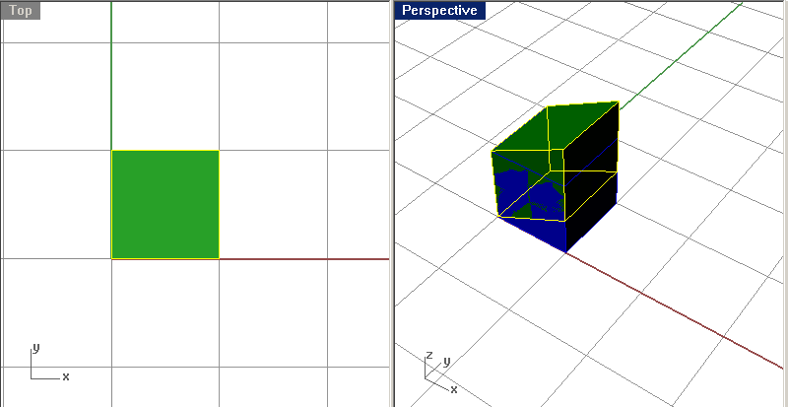
Shear
Notes:
Variables can be
Numerical
Integers

Slide 46
Translation
We can morph,
what about simple translations (moving?)
=
=
Answer: homogenous coordinates
Notes:
Variables can be
Numerical
Integers

Slide 47
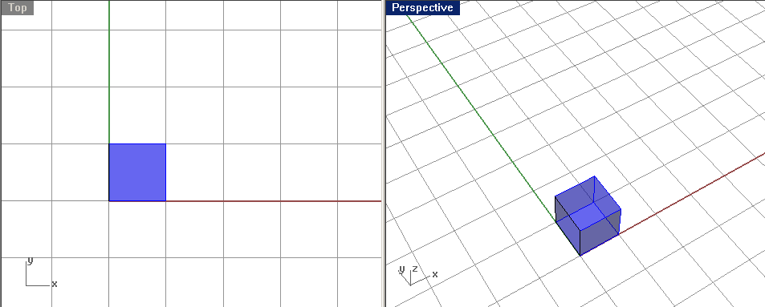
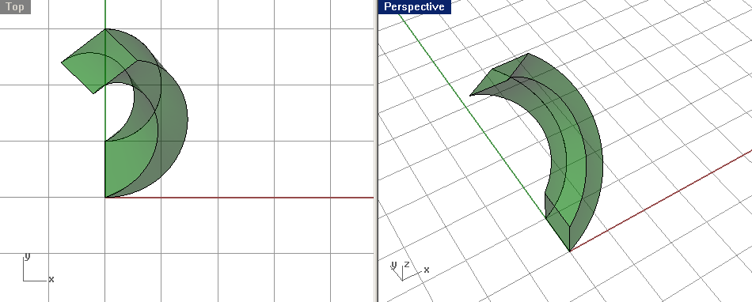
Linear Transformation
This is a particular, highly specialized and simplified, version of a transformation.
The general transformation is:
Some complicated
function_{x}(x_{old}, y_{old}, z_{old})
Some complicated
function_{y}(x_{old}, y_{old}, z_{old})
Some complicated
function_{z}(x_{old}, y_{old}, z_{old})

Slide 48
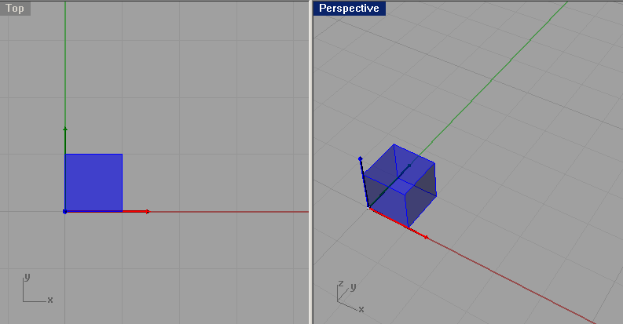
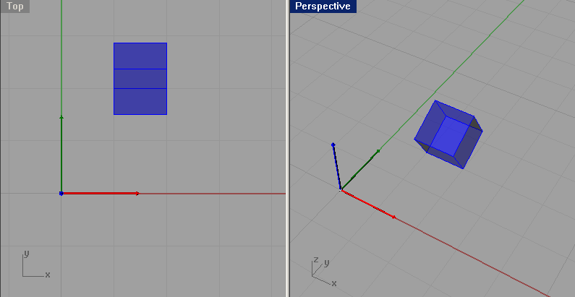
Linear Transformation
Here, we’re talking about very simple behavior:

Slide 49
Linear Transformation
Here, we’re talking about very simple behavior:
The contribution of each “old” parameter on each “new” parameter
is a constant, multiplier

Slide 50
Linear Transformation
Here, we’re talking about very simple behavior:
The contribution of each “old” parameter on each “new” parameter
is a constant, multiplier
The contribution of each “old” parameter on each “new” parameter
is a constant, multiplier
The net result is a simple addition of
each contribution

Slide 51
Linear Transformation
Here, we’re talking about very simple behavior:
The 3 functions are completely independent

